Slide 1

01
Le Wagon + SkillPilot 🚀
QHack25
Team: THA_Augsburg

Slide 2
02
The Problem
!
Learning to Code Can Be Frustrating
Students don't know how they are performing
Students get stuck on errors and get overwhelmed
Teachers are overwhelmed with repetitive help tickets
Feedback often arrives too late to be effective

Slide 3
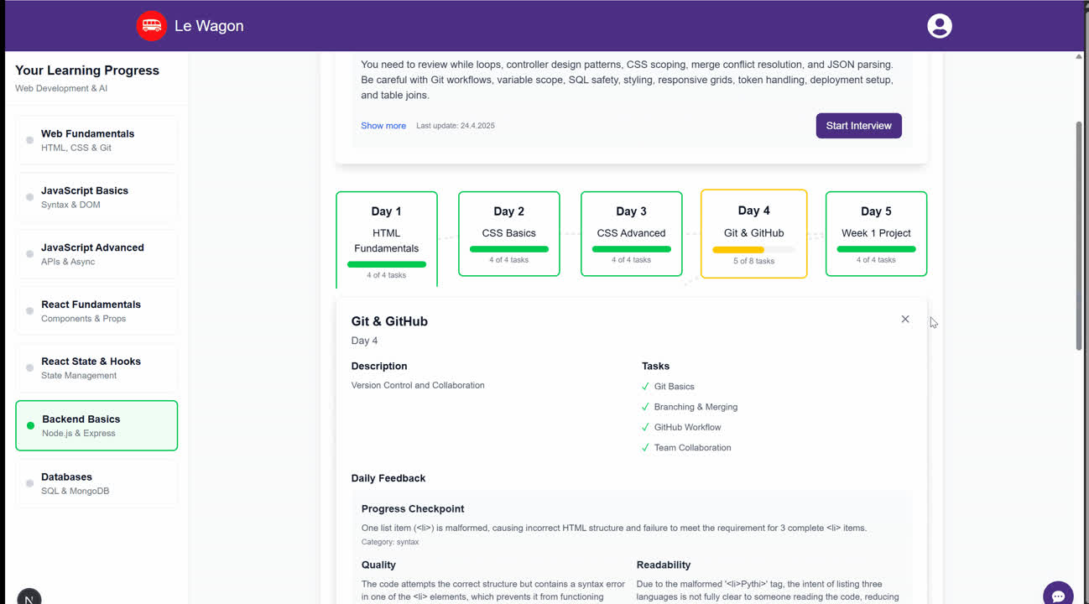
Feature 1
03
Progress Tracking
Personalized
Daily up-to-date performance overview
Highlights individual weak spots and patterns
Combines feedback, task type & failure reasons into clear reports

Slide 4
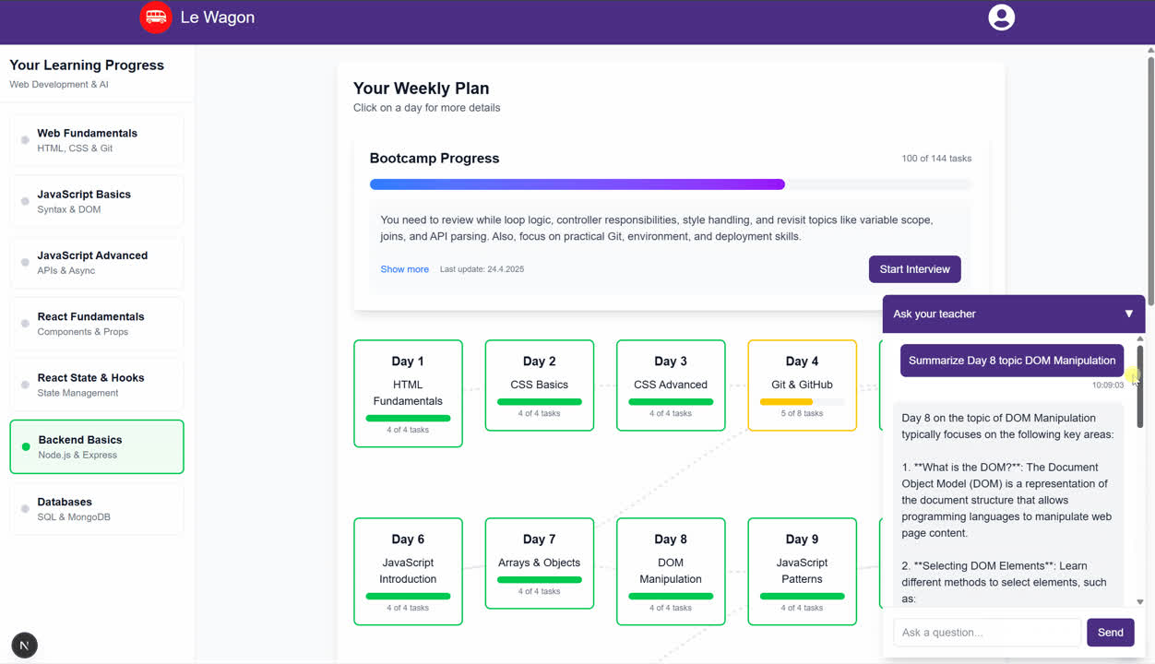
Feature 2 & 3
04
Smart Explanations On the Spot
Real-time error resolution with context-aware suggestions
Saves time for both student and instructor
Code Review Automation
Feedback on structure, logic, and clarity
Better solution suggestions
Technical thinking training

Slide 5
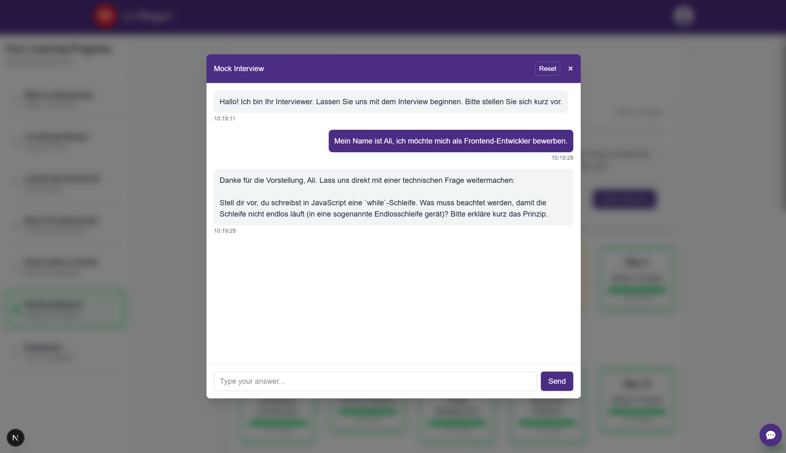
Feature 4
05
Mock job interview
Asks the right questions
Gives real-time feedback
Knows your skills and profile

Slide 6
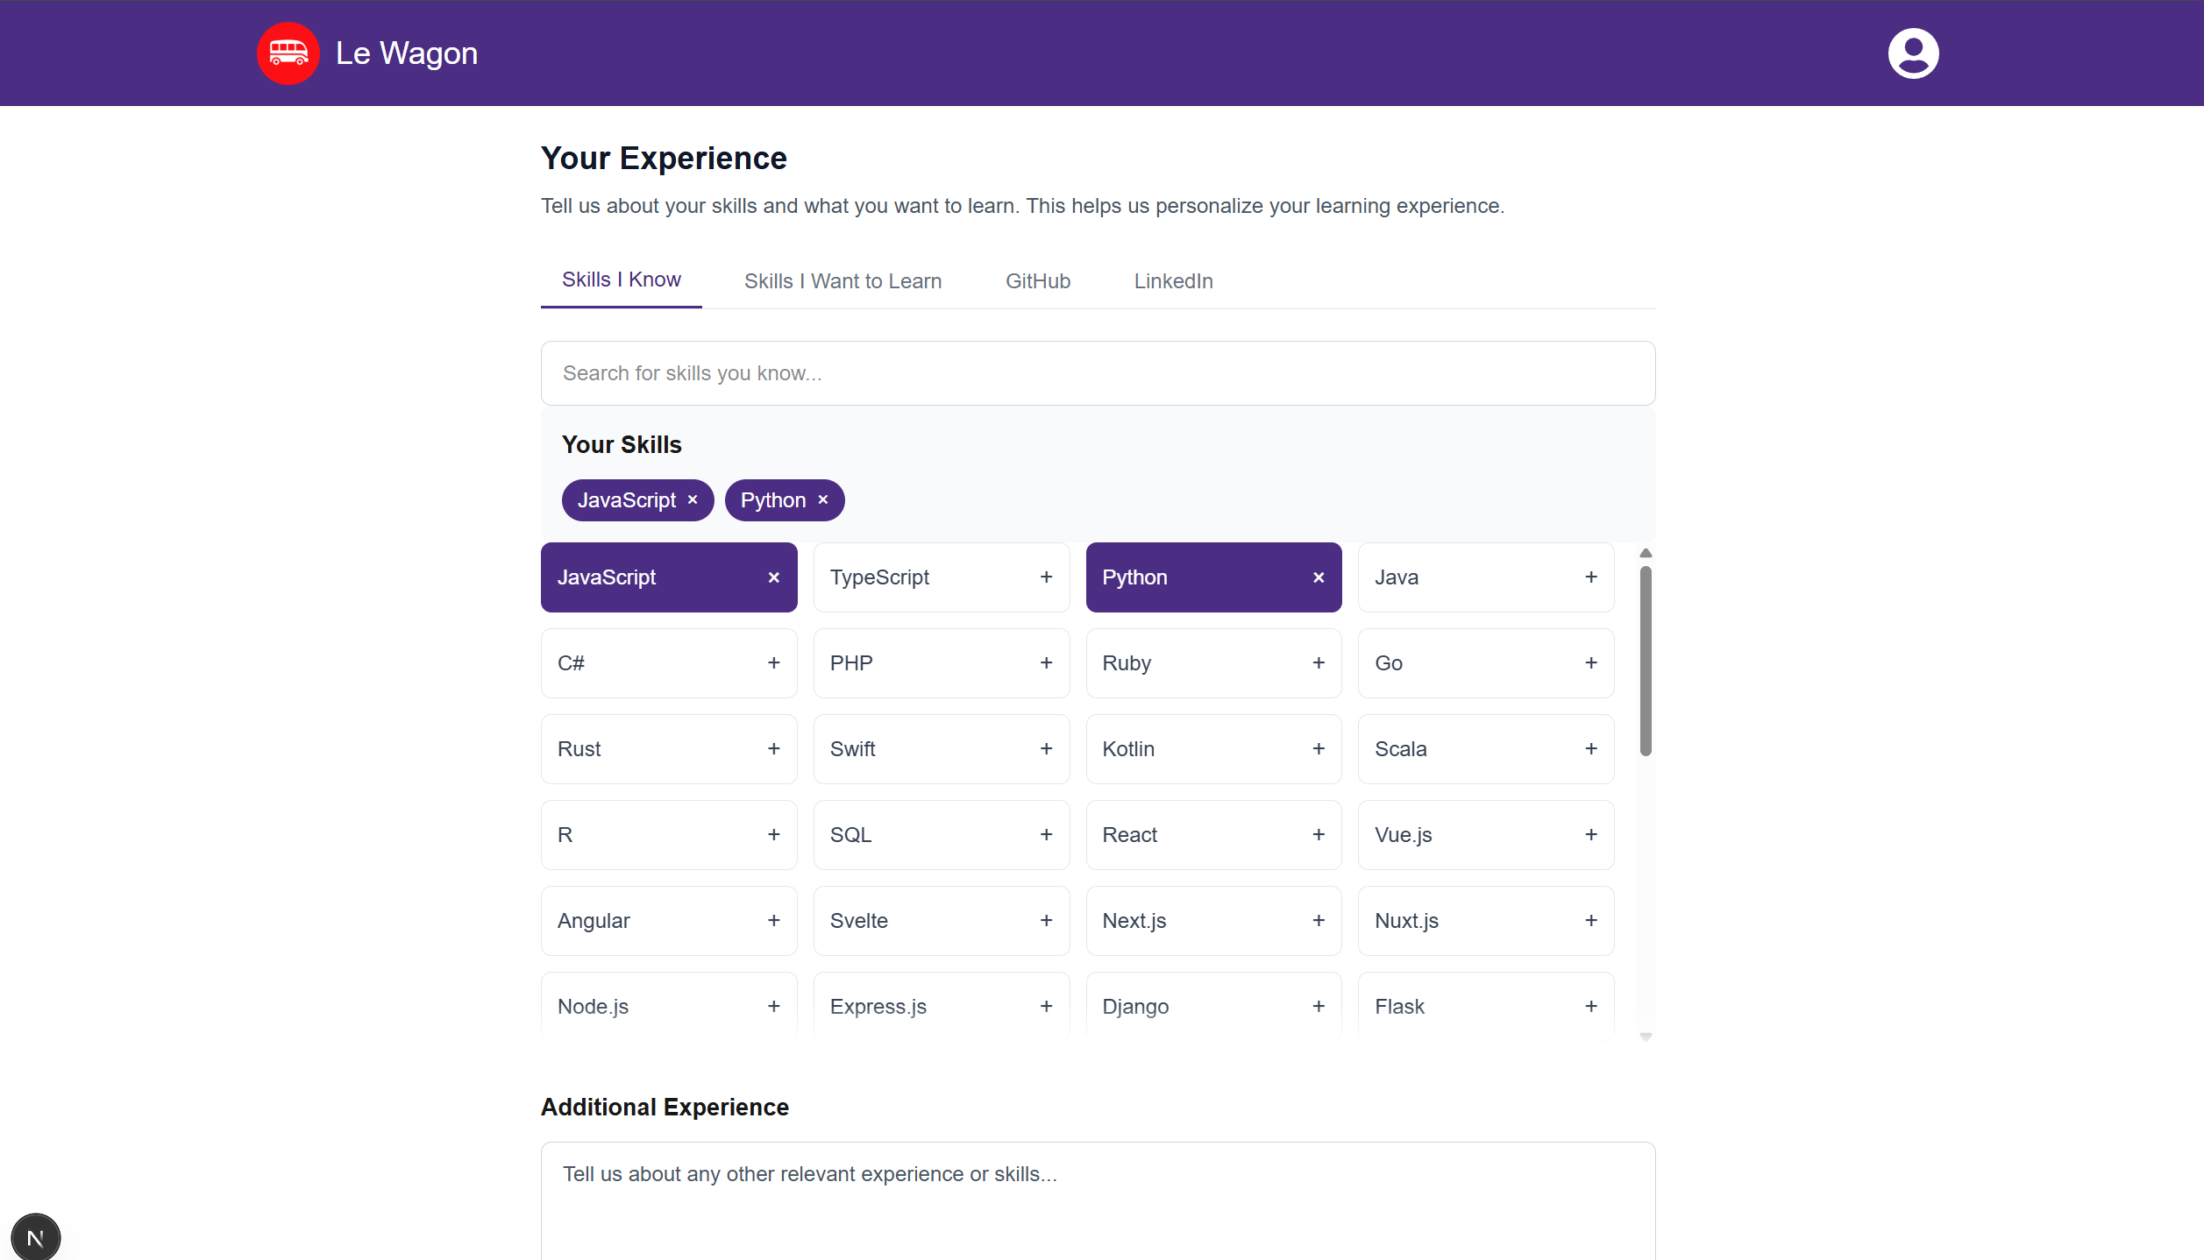
Feature 4
05
Personalized Student Profile
Consider student background and previous skills
Interested skills to be learned
Profiling using GitHub and LinkedIn

Slide 7
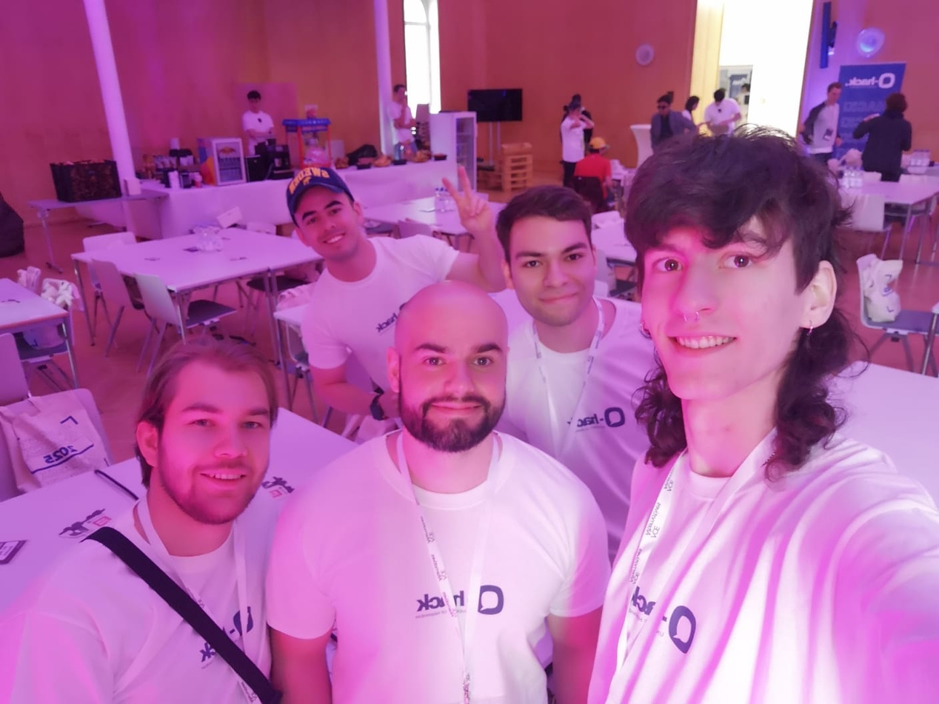
08
Our Team
Mikhail Legkii
Florian Schneller
Ali Aqa Rasikh
Nikita Aksjonov
Philipp Mukosey
THA Augsburg

